Slide 1
Information Security Risk & Compliance (ISRC)
Wiz Code at Bayview
Henry Post - May 2026

Slide 2

Meta slide
Who are you?
  Nice to meet you! I’m Henry Post. I lead AppSec and I’ve been at Bayview for 3 years, US Bank for 4 years previously. I love baking, cooking, fighting games, gardening, weightlifting, and am currently studying for the OSCP exam (hacking exam). I specialize in Application Security and penetration testing. My personal site is https://drakonix.systems/ if you’re curious about other projects I’ve worked on. I host some infra there for animal shelters.
How did you generate your diagrams?
  I use Mermaid to generate diagrams. If I could, I would use LaTeX or pure Markdown plus pandoc CLI for deterministic formatting for this entire PPTX.
    https://github.com/Mermaid-Chart/vscode-mermaid-chart
Are there guides related to AppSec?
  Yes! There are many below.
    https://bayview0.sharepoint.com/sites/ApplicationSecurity

Slide 3
What is Wiz? 1
Wiz started as a cloud misconfiguration scanning tool.
  It’s recently gotten a lot of more features around code scanning and was purchased by Google.
What does AppSec use it for?
  Wiz can replace Snyk for code scanning.
  It can do SAST (Code scanning), IaC (Infra as Code scanning), SCA (3rd party dependency scanning for CVEs), and Secrets scanning.
  It covers the gaps that StackHawk leaves, as StackHawk can only scan for DAST (Automated web pentesting) vulnerabilities.
Is there a guide?
  Yes! I wrote a very detailed guide for developers. It will be updated frequently as people continue to use Wiz.
https://bayview0.sharepoint.com/sites/ApplicationSecurity/SitePages/Wiz-Dev-Quick-Start-Guide.aspx

Slide 4
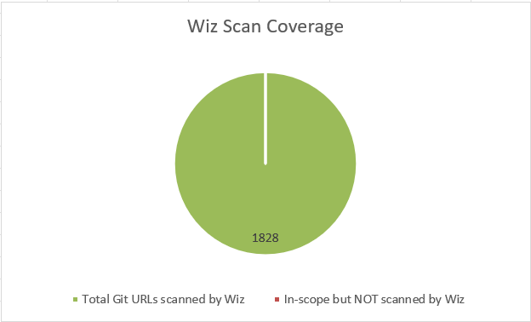
What is Wiz? 2
We currently have excellent scan coverage, thanks to all who helped me set up “Connectors” between Git providers and Wiz. As far as I know, every Git repository we code in, is scanned.
Previously with Snyk, we had slightly worse (200 unscanned repos) coverage due to connector issues and noise from Snyk.

Slide 5
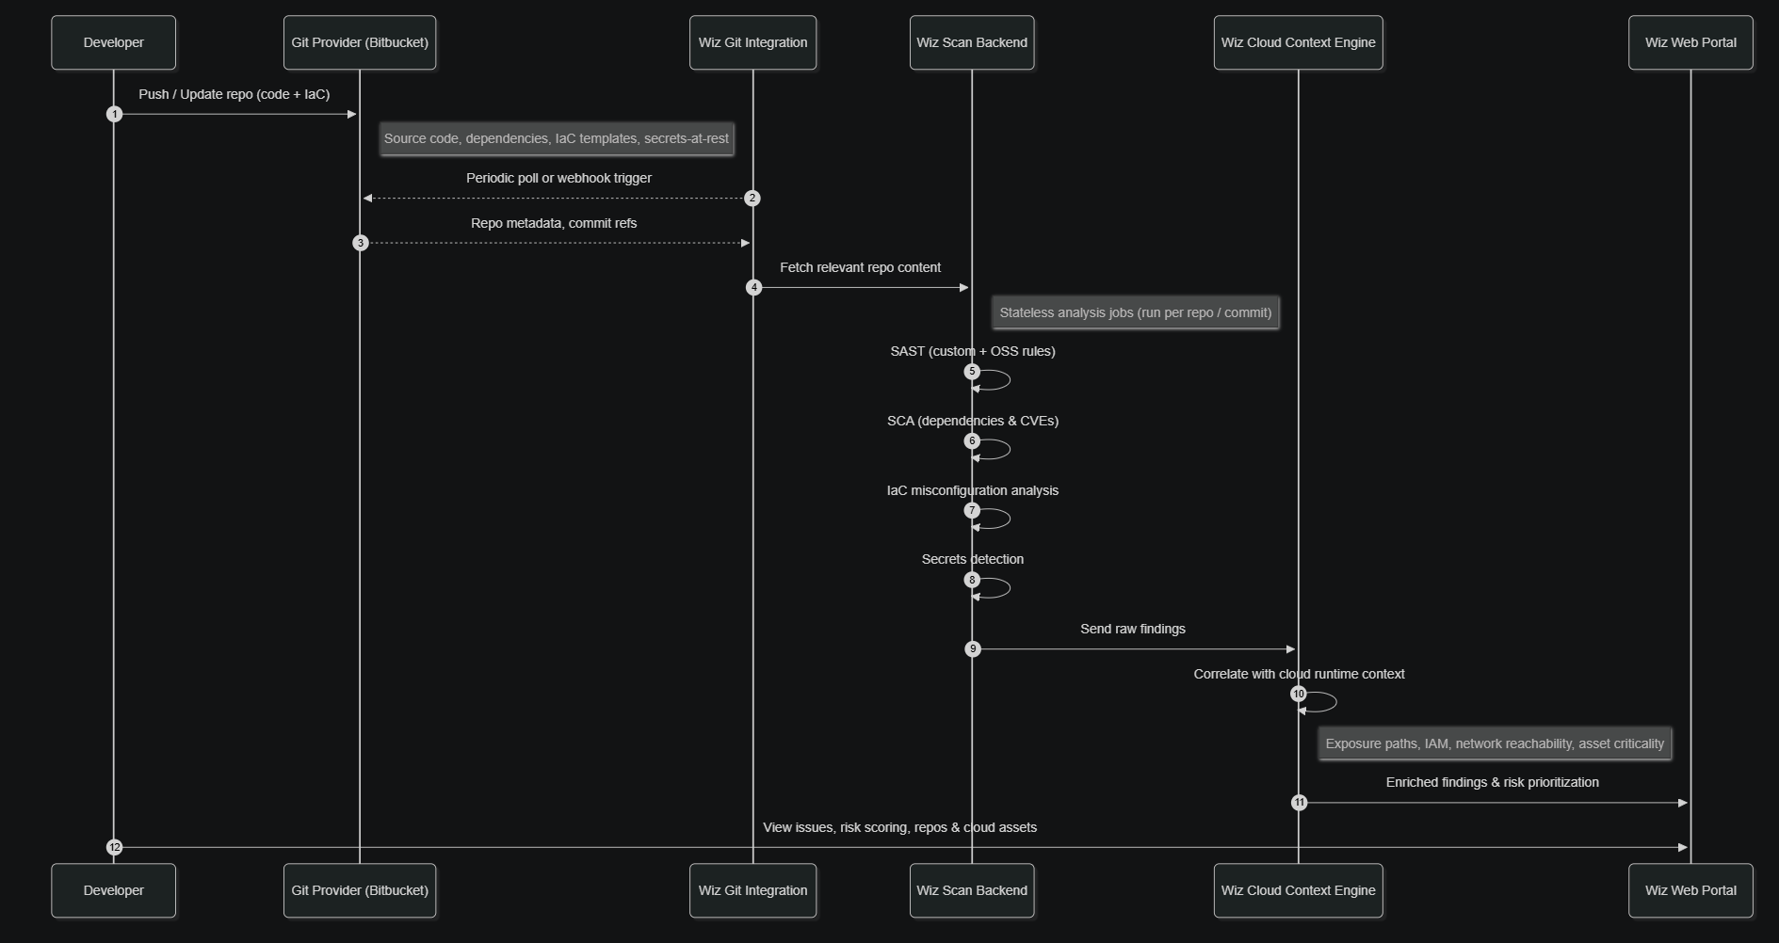
What is Wiz? 3
Wiz connects directly to Git repositories, or can be used in the IDE. Below is a diagram of how the data flows between Git providers like BitBucket, and Wiz.
Dev POV: Commit, push, view results.
Generate a mermaid diagram that outlines how Wiz does SAST/IaC/Secrets/SCA scanning - their scan backend periodically connecting to Git providers like BitBucket, and then showing results in their web portal. make it a sequence diagram.

Slide 6
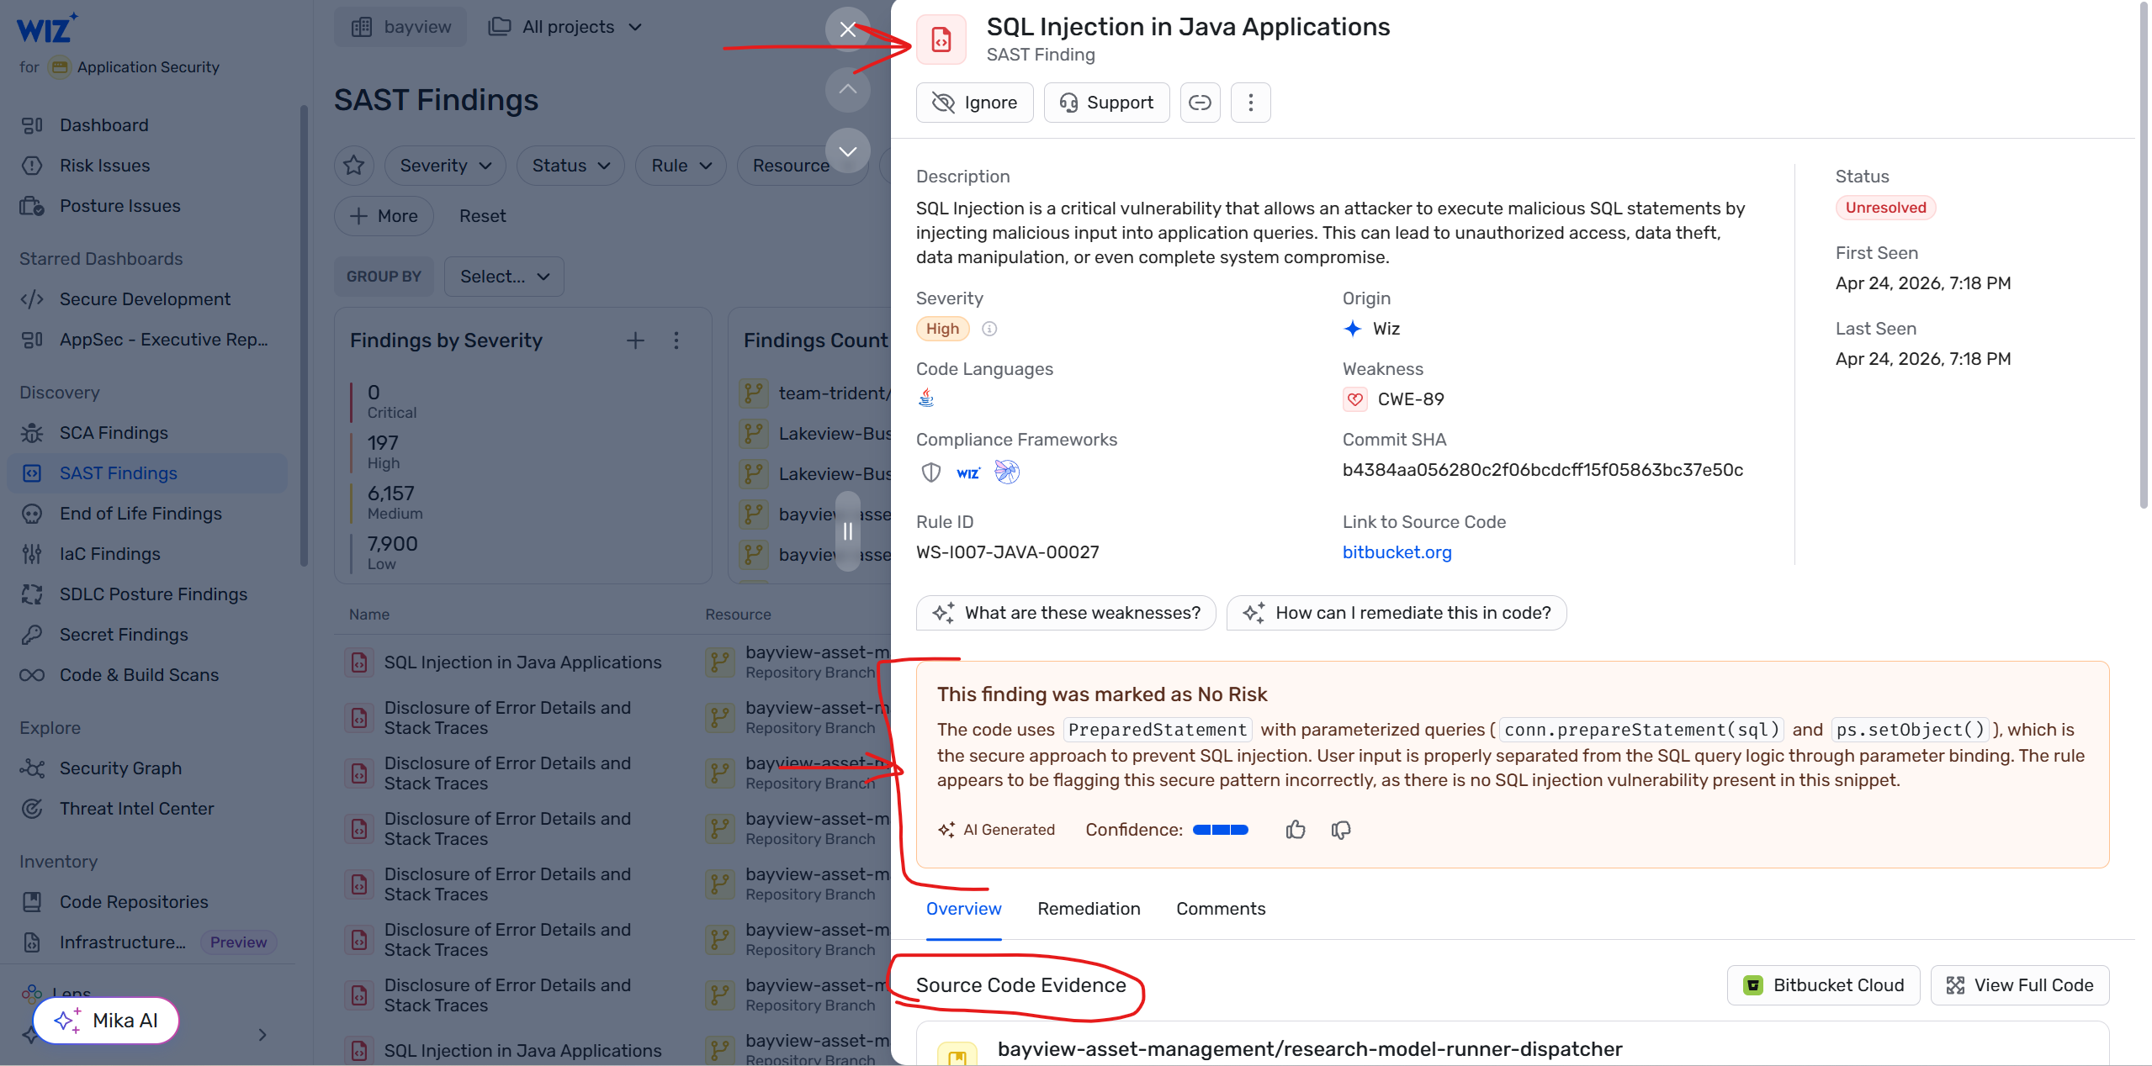
What is Wiz? 4
Once scans are done, users can view findings in Wiz’s web portal.
Users can also use IDE plugins to view scan findings immediately in their IDE.
  This is preferred for developers, as it is a faster feedback loop.
In this example, this Wiz finding was marked as “No Risk” due to mitigations; being the use of prepared statements in SQL.
  Wiz is able to analyze code using AI to make determinations like this, greatly reducing scan tool noise.

Slide 7
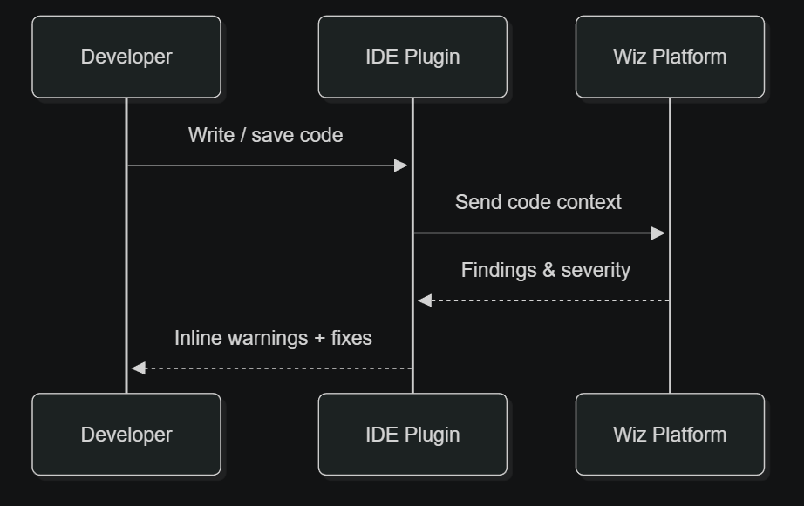
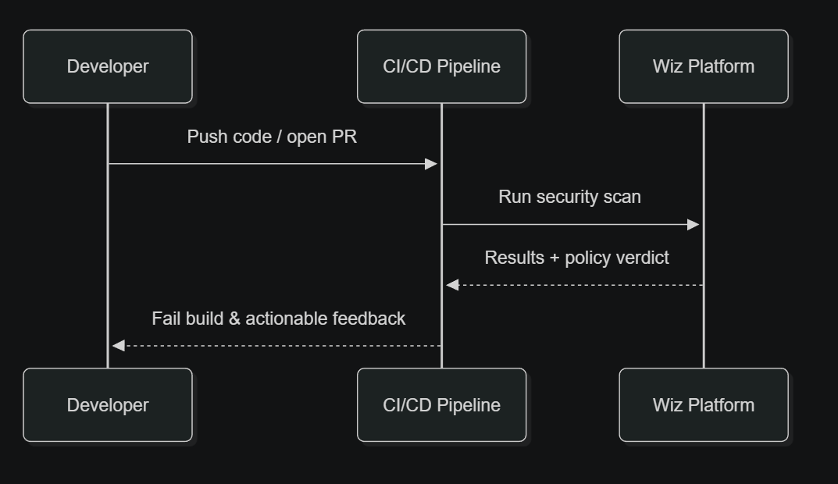
Wiz: How do we automate it?
Good news: We already get automatic scans. Once you commit and push, you’ll get results.
It is recommended to do a few things, though, to make the feedback loop tighter:
  Use Wiz IDE Plugins. This brings the results closer to the software developer.
  Run Wiz scans in CICD. This can automatically break builds if Wiz finds any high or critical vulnerabilities.
Wiz IDE Plugin Scan
Wiz CICD Pipeline Scan
Generate two short mermaid sequence diagrams showing how Wiz IDE plugins work, and also how Wiz CICD scans work to break builds and give devs quick feedback.

Slide 8
Wiz: What about shadow IT from citizen developers/vibe-coding?
AI giving almost everyone (who has access to it) the ability to write code is fantastic, but it carries risks:
  Shadow IT: People developing software outside of any SDLC or documented business process
    What if they don’t version control it?
    What if they don’t set up authentication or authorization controls?
    What if their vibe-coded app contains logic errors that SAST tools can’t detect like zero auth or missing RBAC?
    What if their vibe-coded app doesn’t actually check their role in AD but still grants them access to a sensitive resource like loan data?
Wiz has an answer for this in the form of SAST scanning for vulnerabilities, but we can’t do it with tools alone.
  Adding DAST scanning will find more vulnerabilities, but again, it won’t detect high-level logic-based flaws due to the nature of SAST and DAST tools.
Connecting with “citizen developers” (those who aren’t developers but started writing code) and teaching them how to safely do software development is the best choice.
  It enables them to continue developing code for the business
  It lets us teach them how to use Git to version source code
    …and this lets us get free Wiz SAST/SCA/IaC/Secrets scans as a bonus.
  It lets us audit their authentication and authorization checks and ask other architectural questions
“Total Bans” on vibe coding are likely very hard to enforce
  Is a single PowerShell script a web application? What if it hosts a lightweight API?
  What about a tiny Python flask web server with 2 endpoints?
  What about a larger Python flask web server with a front-end?
Regardless of the use case for citizen developers, establishing trust and connecting with them and educating them is the best way to prevent Shadow IT.
  I partnered with the Desktop Engineering team to teach them how to use Git and start scanning their “commandcenter” project’s code with Wiz. Big thank you to that team for being open to learning!

Slide 9
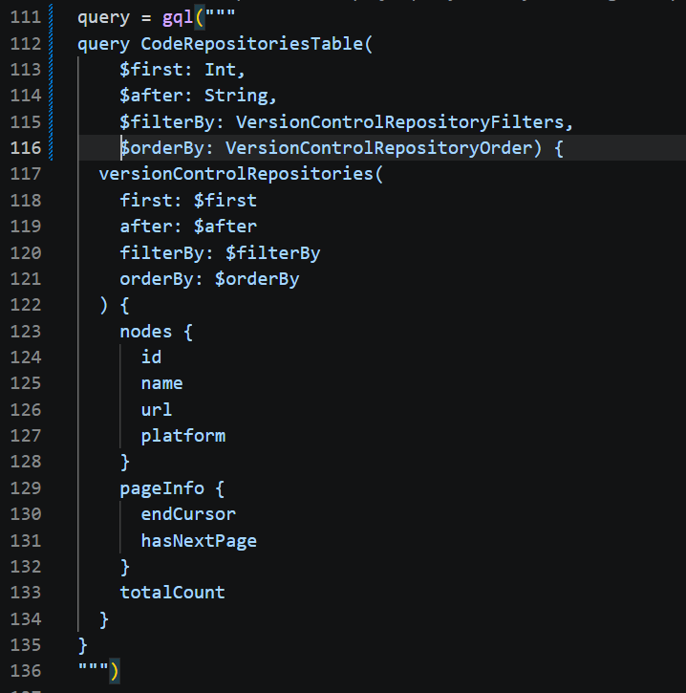
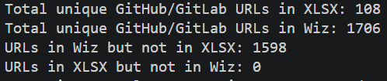
Wiz: Can we automate data collection from Wiz’s API?
Yes! I’ve written a simple script that collects data from Wiz’s GraphQL endpoint to see what our Git repo scan coverage is.
  https://bitbucket.org/bayview-asset-management/wizgitrepocoverage/src
Wiz stores data on cloud assets, accounts, Git repositories, vulnerabilities, virtual machines, Docker images, and many more objects.
  All of these are queryable either in the web UI, or the API.
This is how I generated the pie chart a few slides back.
The benefit of the GraphQL API is that you specify the data you /want/, and the server mutates it for you. No post-GET data massaging needed.
Wiz even has an AI model that helps you build queries on their graph database.
  i.e. “Show me all Azure VMs connected to production databases”
  “Show me all secrets that might be exposed if source code were leaked”

Slide 10
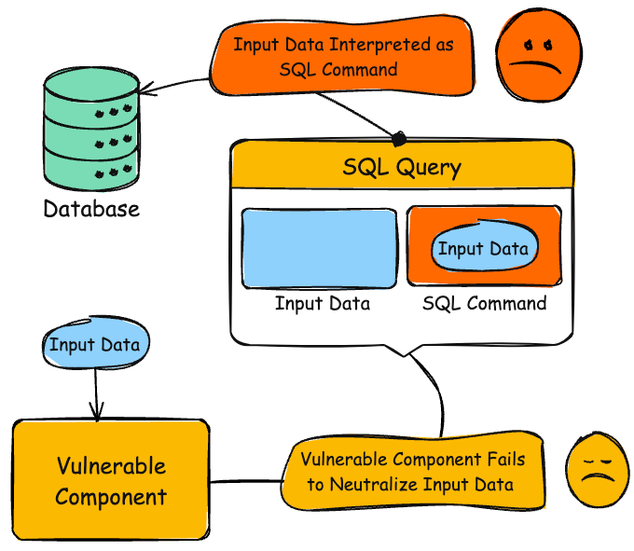
Wiz: How do we fix SAST issues?
For SAST issues, code changes are how we fix vulnerabilities.
  Wiz will tell you if it thinks a SAST finding is valid or not. “AI Verdict” is the filter you can use.
  Example: SQL Injection
string userName = ctx.getAuthenticatedUserName();
string query = "SELECT * FROM items WHERE owner = '" + userName + "' AND itemname = '" + ItemName.Text + "'";
sda = new SqlDataAdapter(query, conn);
DataTable dt = new DataTable();
sda.Fill(dt);
Fixed version:
string userName = ctx.getAuthenticatedUserName();
string query = @"
SELECT *
FROM items
WHERE owner = @owner
AND itemname = @itemname";
using (SqlCommand cmd = new SqlCommand(query, conn))
{
cmd.Parameters.Add("@owner", SqlDbType.NVarChar, 256).Value = userName;
cmd.Parameters.Add("@itemname", SqlDbType.NVarChar, 256).Value = ItemName.Text;
using (SqlDataAdapter sda = new SqlDataAdapter(cmd))
{
DataTable dt = new DataTable();
sda.Fill(dt);
}
}
``

Slide 11

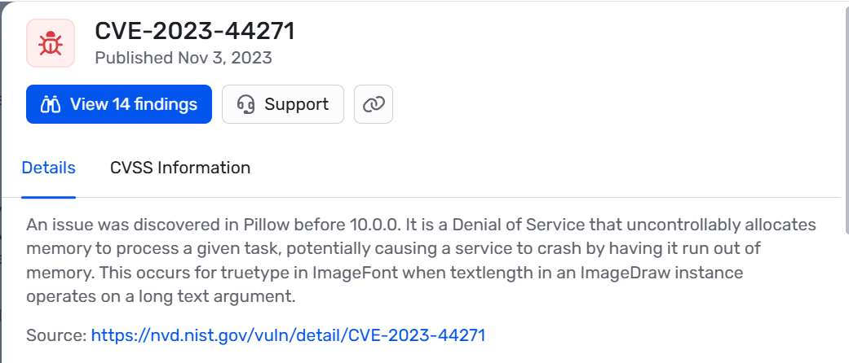
Wiz: What about fixing SCA issues?
SCA issues are trickier to fix. Specifically, what if upgrading our package causes breaking changes?
  I will go into this in my roadmap in more detail.
Example: PyGoat, an OWASP intentionally vulnerable app, uses Pillow==9.4.0.
  https://github.com/adeyosemanputra/pygoat
But what if we can’t upgrade to version 10.0.0?
  What if it breaks our native code?
  What if a parent dependency cannot use 10.0.0?
Solution: Vendors like Seal Security.
  TL;DR: “Just use Seal’s 9.4.0-patched version.”
  Seal Security and similar vendors will backport patches to old versions without introducing breaking changes.
  As part of my roadmap, once we get better Wiz SCA adoption, it will likely be necessary to use backported versions to save devs time.
// old API usage 9.4.0
draw = ImageDraw.Draw(im)
draw.line((0, 0) + im.size, fill=128)
draw.line((0, im.size[1], im.size[0], 0), fill=128)
//versus new API (breaking change, example)
// new API usage 10.0.0
draw = ImageDraw.Draw(im, fillAll=128)
draw.line((0, 0) + im.size)
draw.line((0, im.size[1], im.size[0], 0))

Slide 12
Wiz: FAQ and Questions
Why did we switch from Snyk to Wiz? There are a good number of reasons:
  Cost: Wiz is cheaper.
  Capabilities: Wiz can correlate far more data: Cloud assets, docker containers, VMs, security groups, Git access, secret vaults, SAST, SCA, IaC, Secrets findings, CICD setup, databases, serverless architecture, and more.
    Snyk could only show you SAST, SCA, IaC, and Secrets findings.
  Noise: Snyk never prioritized findings by reachability or possible exploitability. Wiz cuts down on noise massively and saves dev teams time by doing post-scan analysis of every finding.
  Enterprise Support: Google recently bought Wiz, which will likely see it change with new features being added.
  Simplicity: Wiz’s integrations with Git providers is slightly simpler than Snyk’s.
How can I start using Wiz?
  Please read my guide on the subject: https://bayview0.sharepoint.com/sites/ApplicationSecurity/SitePages/Wiz-Dev-Quick-Start-Guide.aspx
<Please feel free to ask a question>

